Slide 1
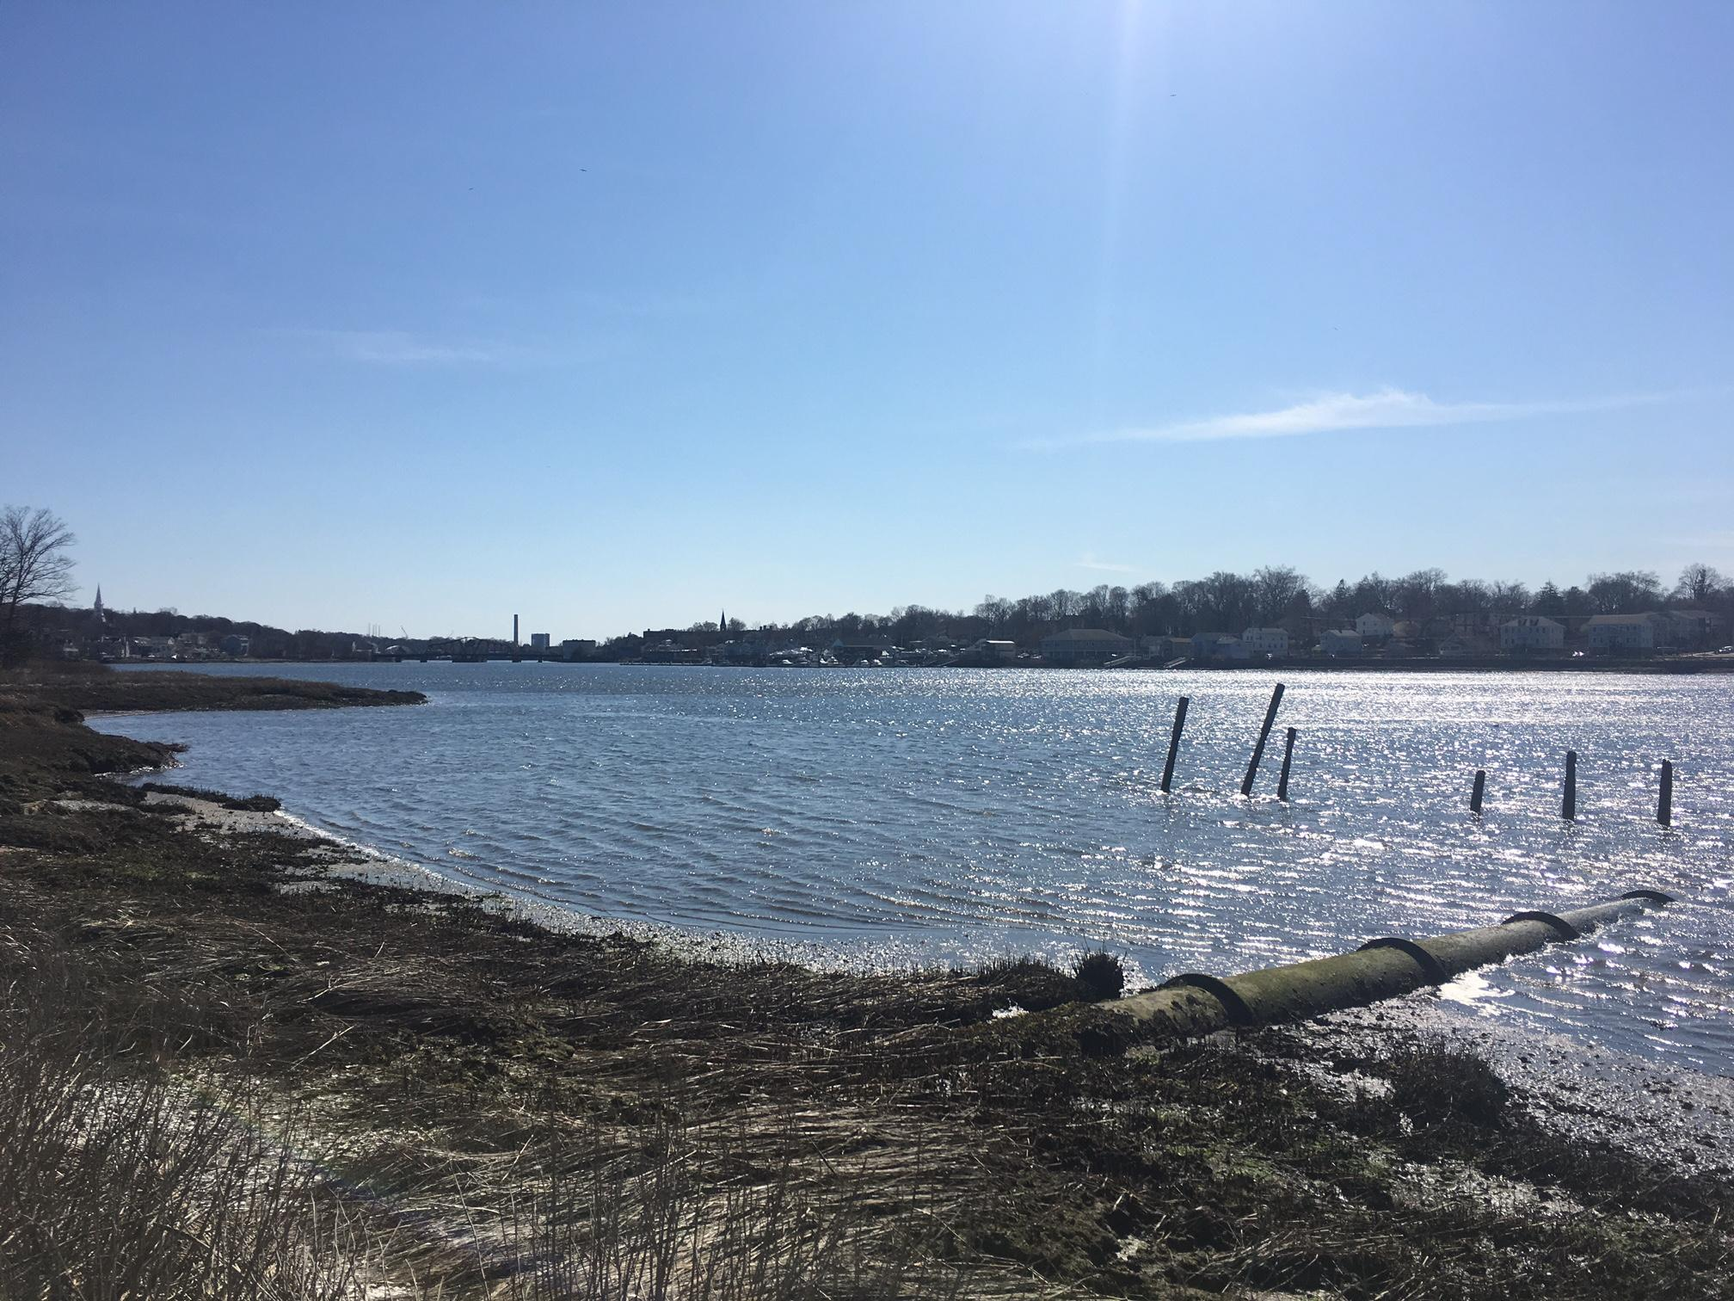
Assessing the Quinnipiac Meadows Site
Course F&ES 741

Slide 2
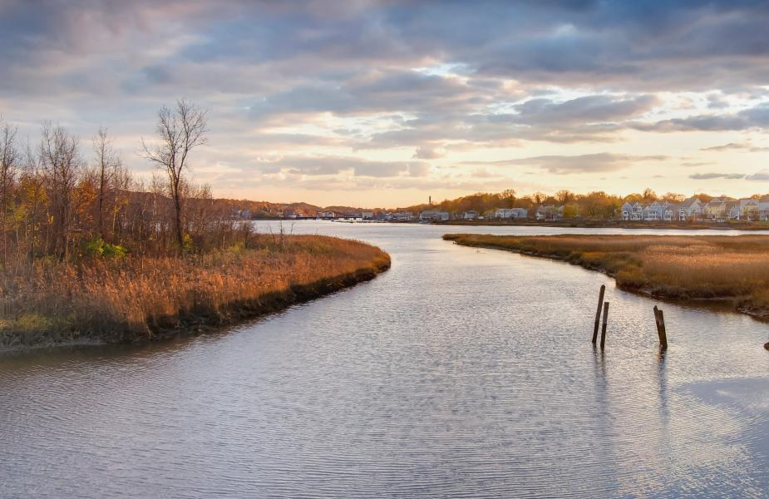
Overview
Land-use History
Vegetation Analysis
Wildlife Survey
Max Farbman

Slide 3
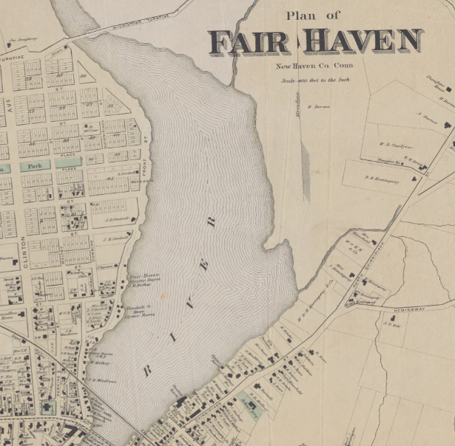
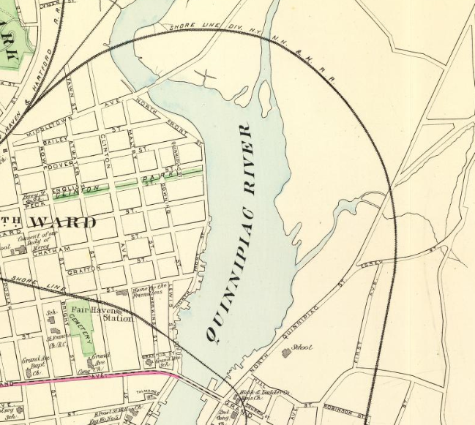
Land-use History
1895
1850s
Notes:
Image: https://www.loc.gov/item/99447265/

Slide 4
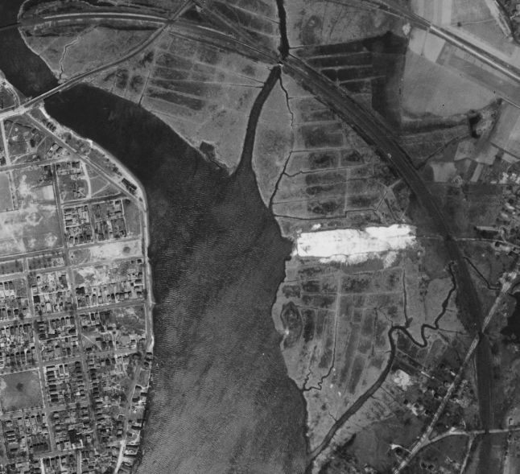
1934
Notes:
We found an original recorded easement between the New Haven Water Company and the Hartford Railroad Company from 1930, indicating that the railroad company had an ownership stake in the property in the early 20th Century. It is possible that the railroad company filled the marsh during the construction of the line to protect its investment.

Slide 5
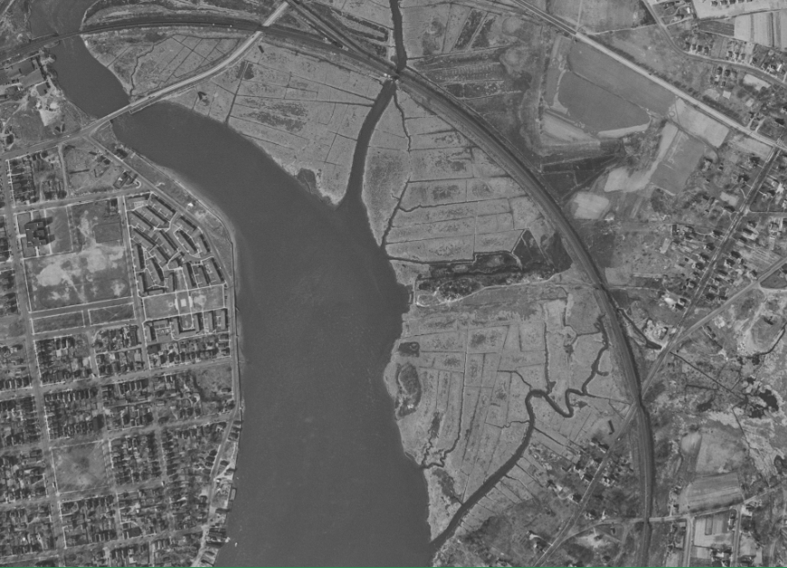
1949

Slide 6
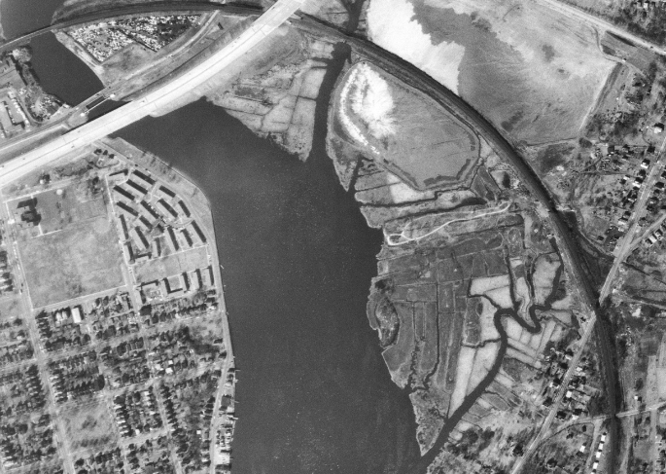
1966

Slide 7
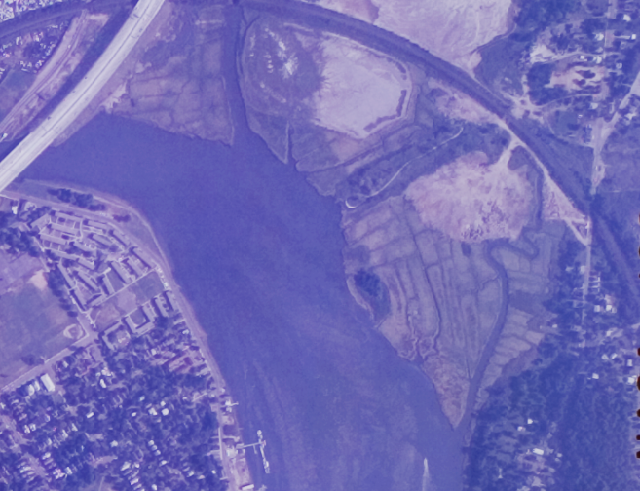
1969

Slide 8
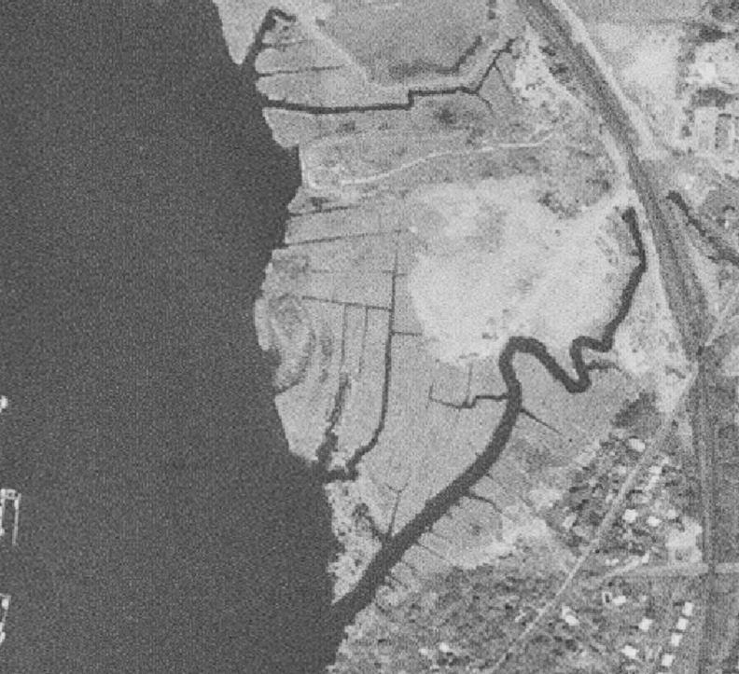
1972

Slide 9
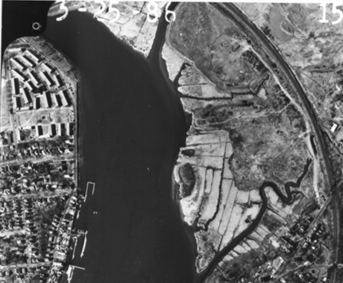
1986

Slide 10
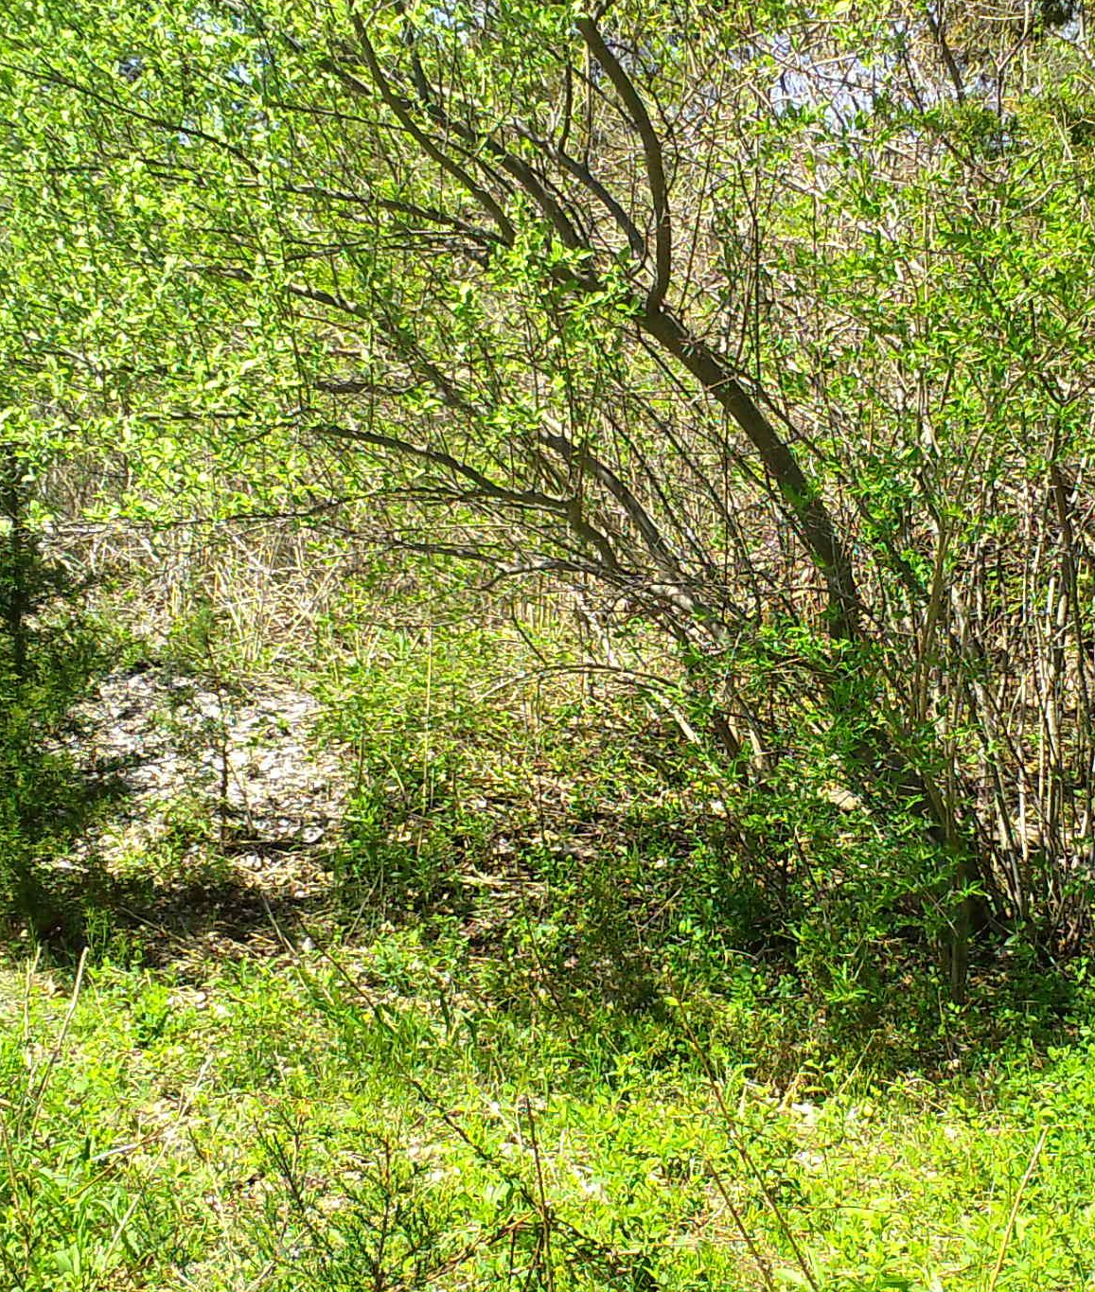
Vegetation Analysis
Species diversity
Area and density measures
Native vs. invasive site occupation
Species and species-environment interactions (inferences)

Slide 11
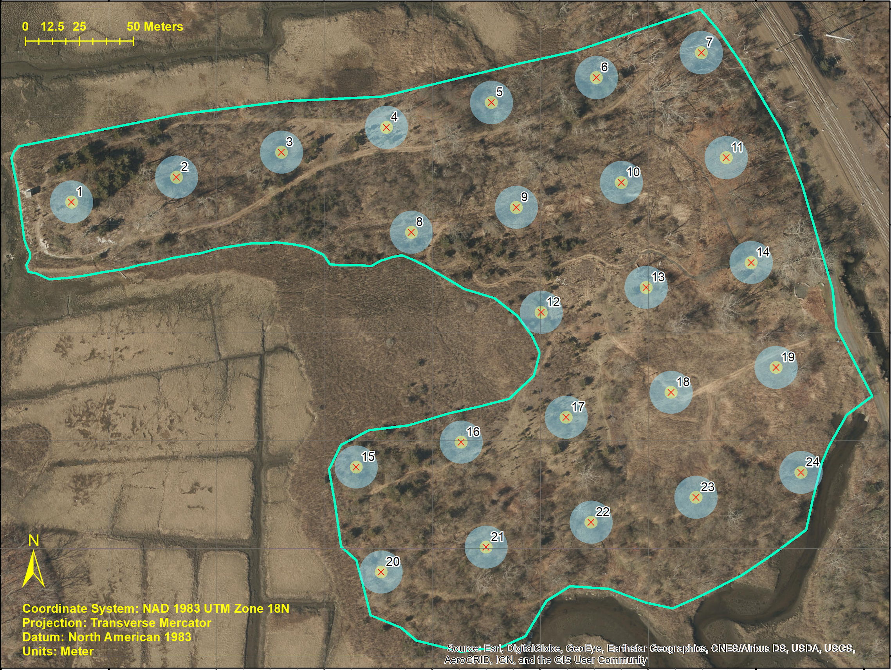
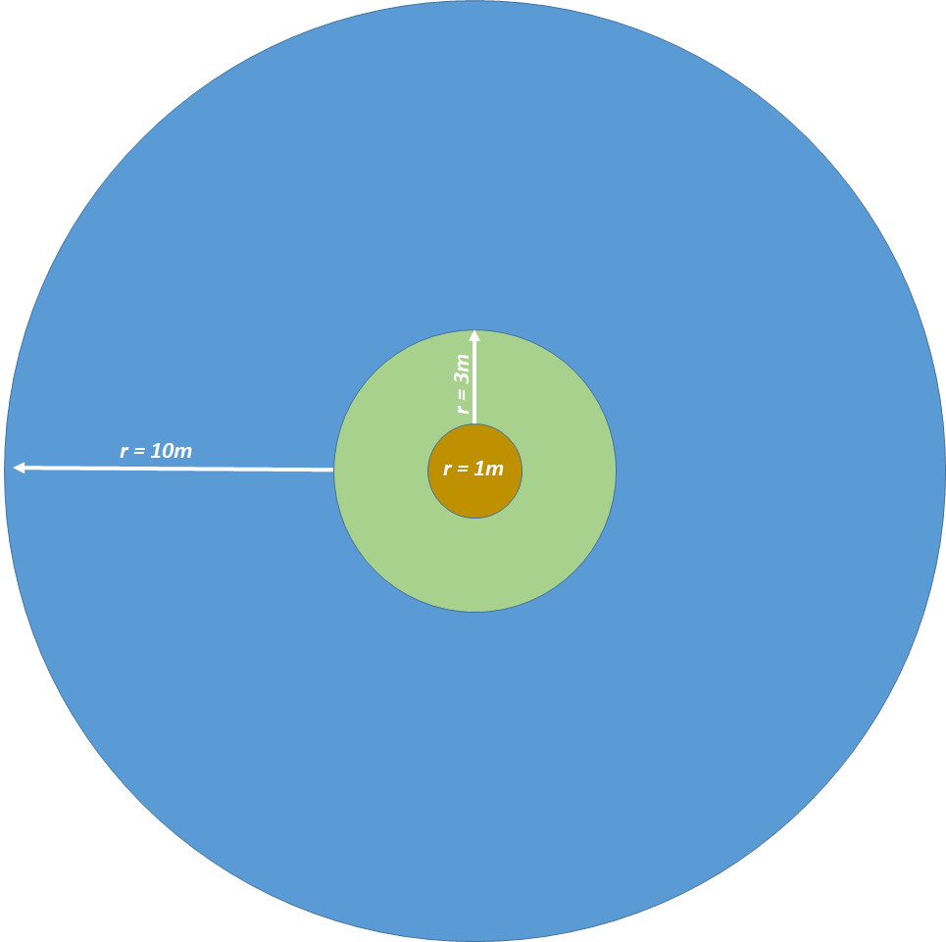
Vegetation Analysis: Sampling Approach
Macro Plot (10m):
Mature/canopy trees
Meso Plot (3m):
Shrubs
Woody vines
Midstory trees
Micro Plot (1m):
Tree seedlings
Invasive herbs
Notes:
Total sample area: 1.86 acres
Total sample area: 0.168 acres
Total sample area: 0.019 acres

Slide 12
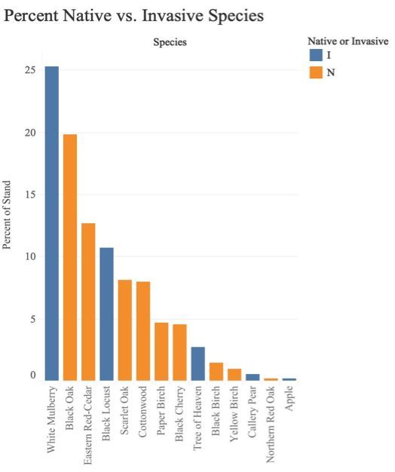
Vegetation Analysis: Canopy Trees
14 unique species
Most abundant:
White Mulberry
Black Oak
Eastern Red-Cedar

Slide 13
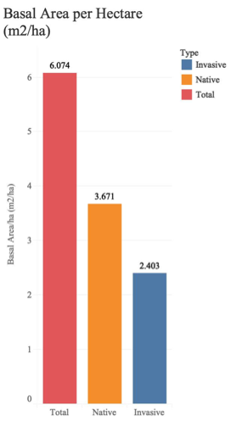
Canopy Trees Key Findings
Basal area of 6.07 m²/ha
In Connecticut upland forests, basal areas range from 1.15 to 75.04 m²/ha, with a mean of 27.08 m²/ha
60% native, 40% invasive
Nearly half of all trees contain an invasive vine species

Slide 14
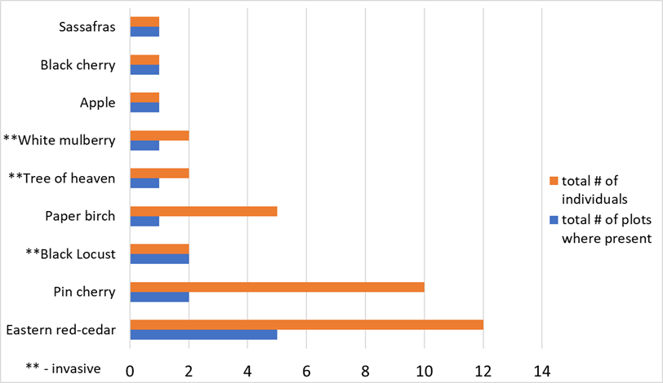
Vegetation Analysis: Midstory Trees
Notes:
MID-STORY
Most abundant:
Eastern red cedar
Pin cherry
Paper birch
Most plot observations:
Eastern red cedar
Pin cherry
Black locust
Overall tree density:
214 trees per acre
Not ubiquitous
Central plots devoid
Native - Invasive Ratio:
5.NAT : 1.INV

Slide 15
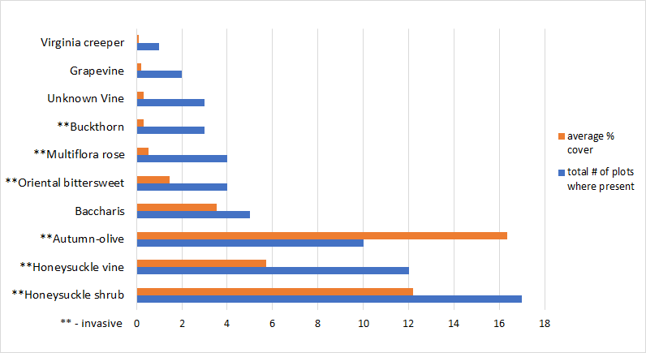
Vegetation Analysis: Shrubs and Woody Vines
Notes:
SHRUBS & WOODY VINES
Most abundant (area cover):
Autumn-olive
Honeysuckle shrub
Honeysuckle vine
Most plot observations:
Honeysuckle shrub
Honeysuckle vine
Autumn-olive
Average of 2+ species/plot
Average shrub/vine area cover:
30% minimum
4.36 acres
Native - Invasive Ratio:
Very strong likelihood of invasive presence

Slide 16
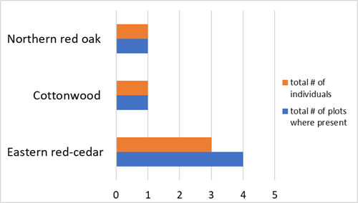
Vegetation Analysis: Tree Seedlings
Notes:
Observed species and occurrences:
Eastern red-cedar
Cottonwood
Northern red oak - planted
Little regeneration captured by sample plots
Concerns/inferences:
Predation pressures?
Resource competition from more abundant invasives at ground and shrub level?
Site quality - conducive to recruitment / seedling survival?
Native - Invasive Ratio:
No invasive tree seedlings observed

Slide 17
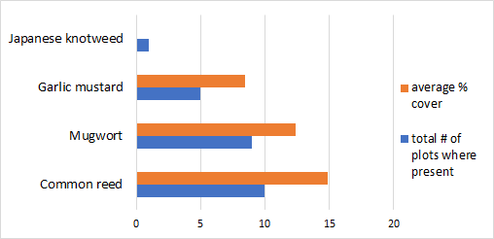
Vegetation Analysis: Invasive Herbs
Notes:
Four species observed in total
Most abundant (area cover) and plot observations:
Common reed (Phragmites australis)
Mugwort
Garlic mustard
Average herb area cover:
34% total minimum cover
5.01 acres (minimum)
Half of invasive herb cover = Phragmites australis

Slide 18
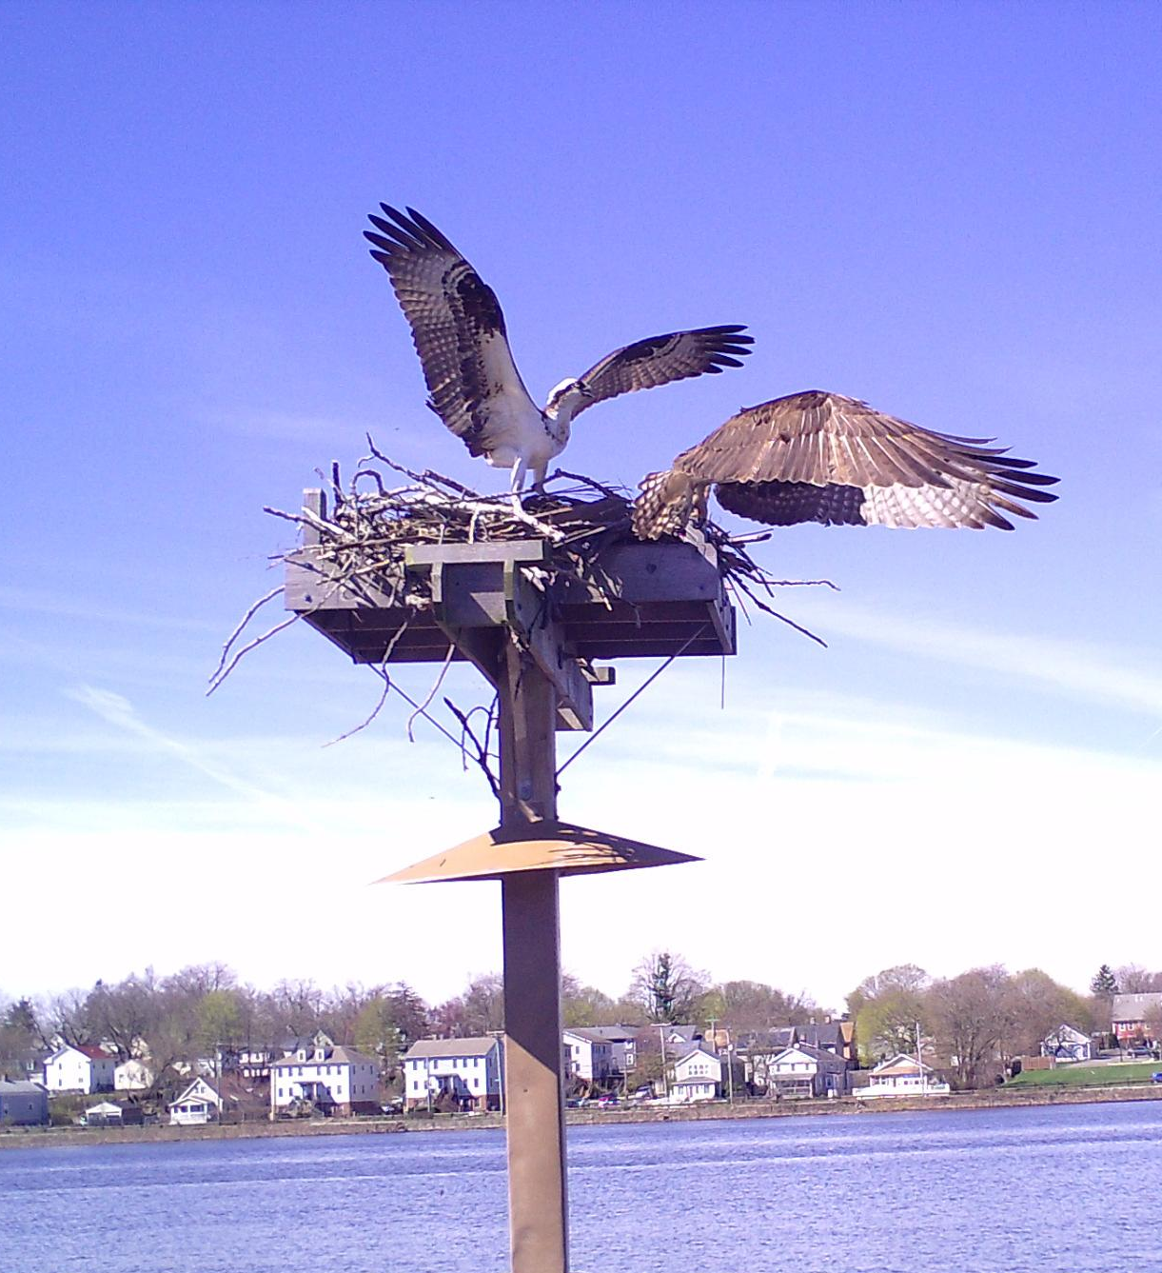
Wildlife Survey
Osprey
Great egret
Robin
Tree swallow
Muskrat
Fox
Racoon
Opossum
Deer
Rabbit
Groundhog
Squirrel
Notes:
Camera Model: Bushnell Trophy Cam HD Essential E3 12MP Trail
We collected approximately 2-weeks of camera trap data.
33,725 pictures total, taken.
Cameras were placed 2-3 feet off the ground and most were secured around tree trunks. Each camera was set to take a burst of three photographs when triggered

Slide 19
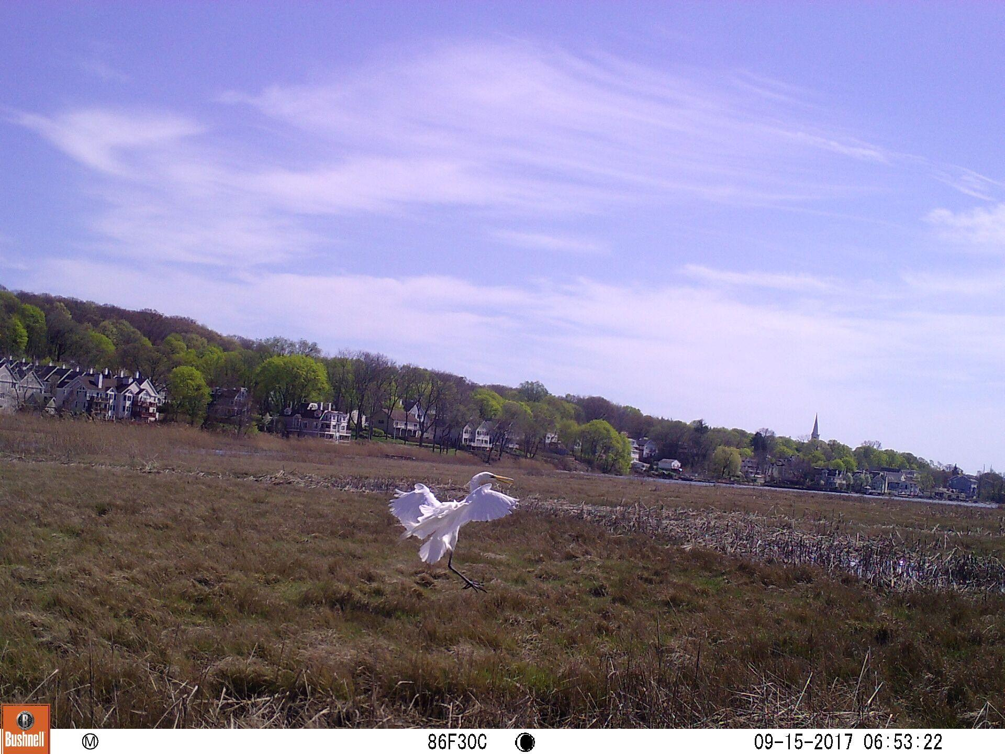
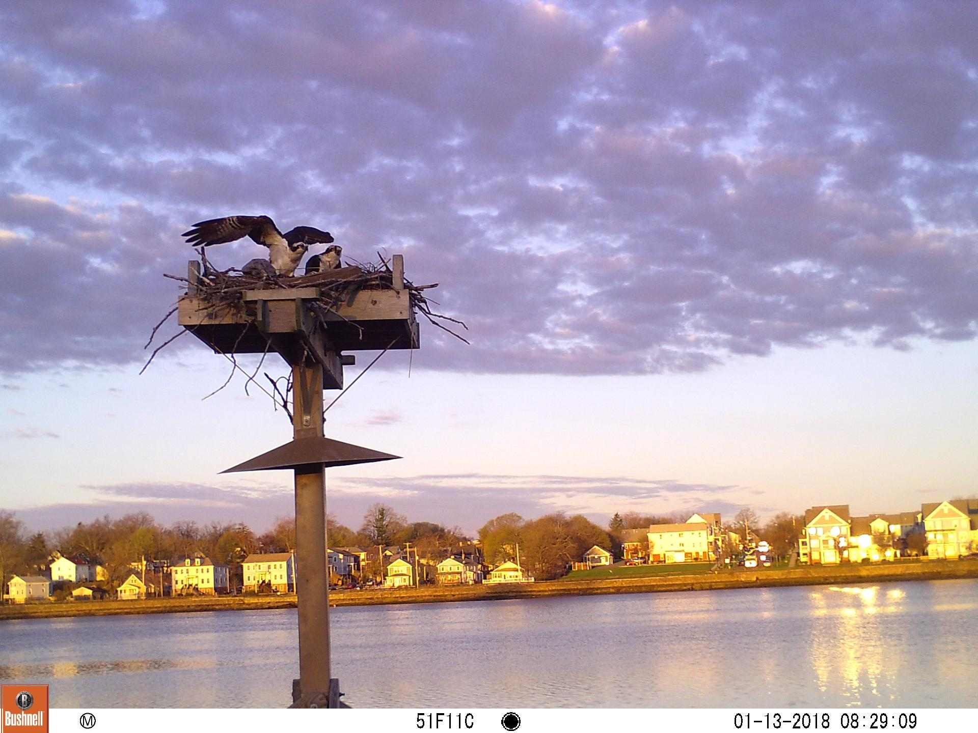
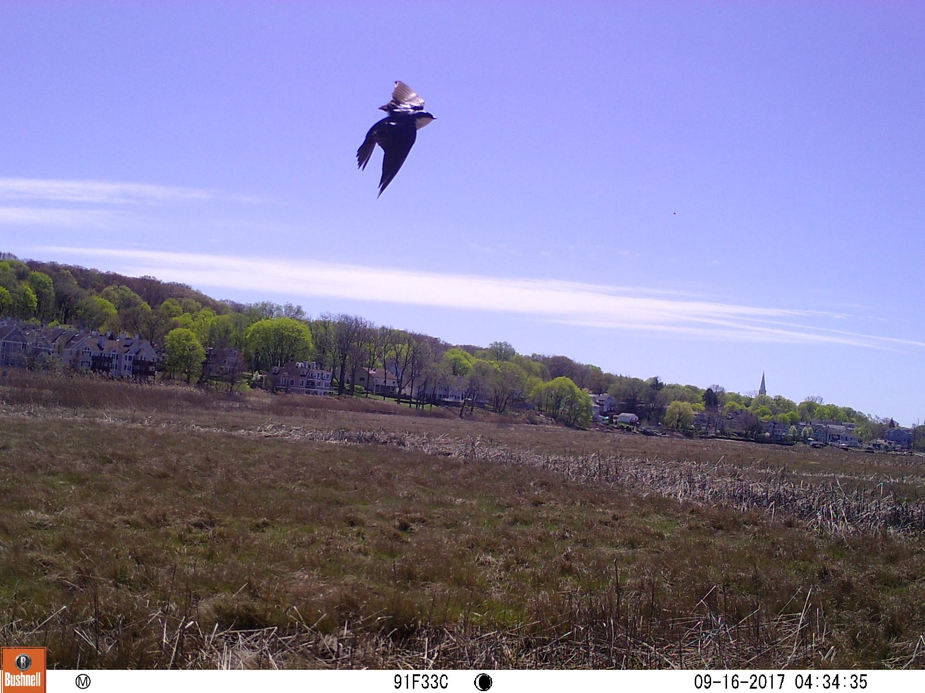
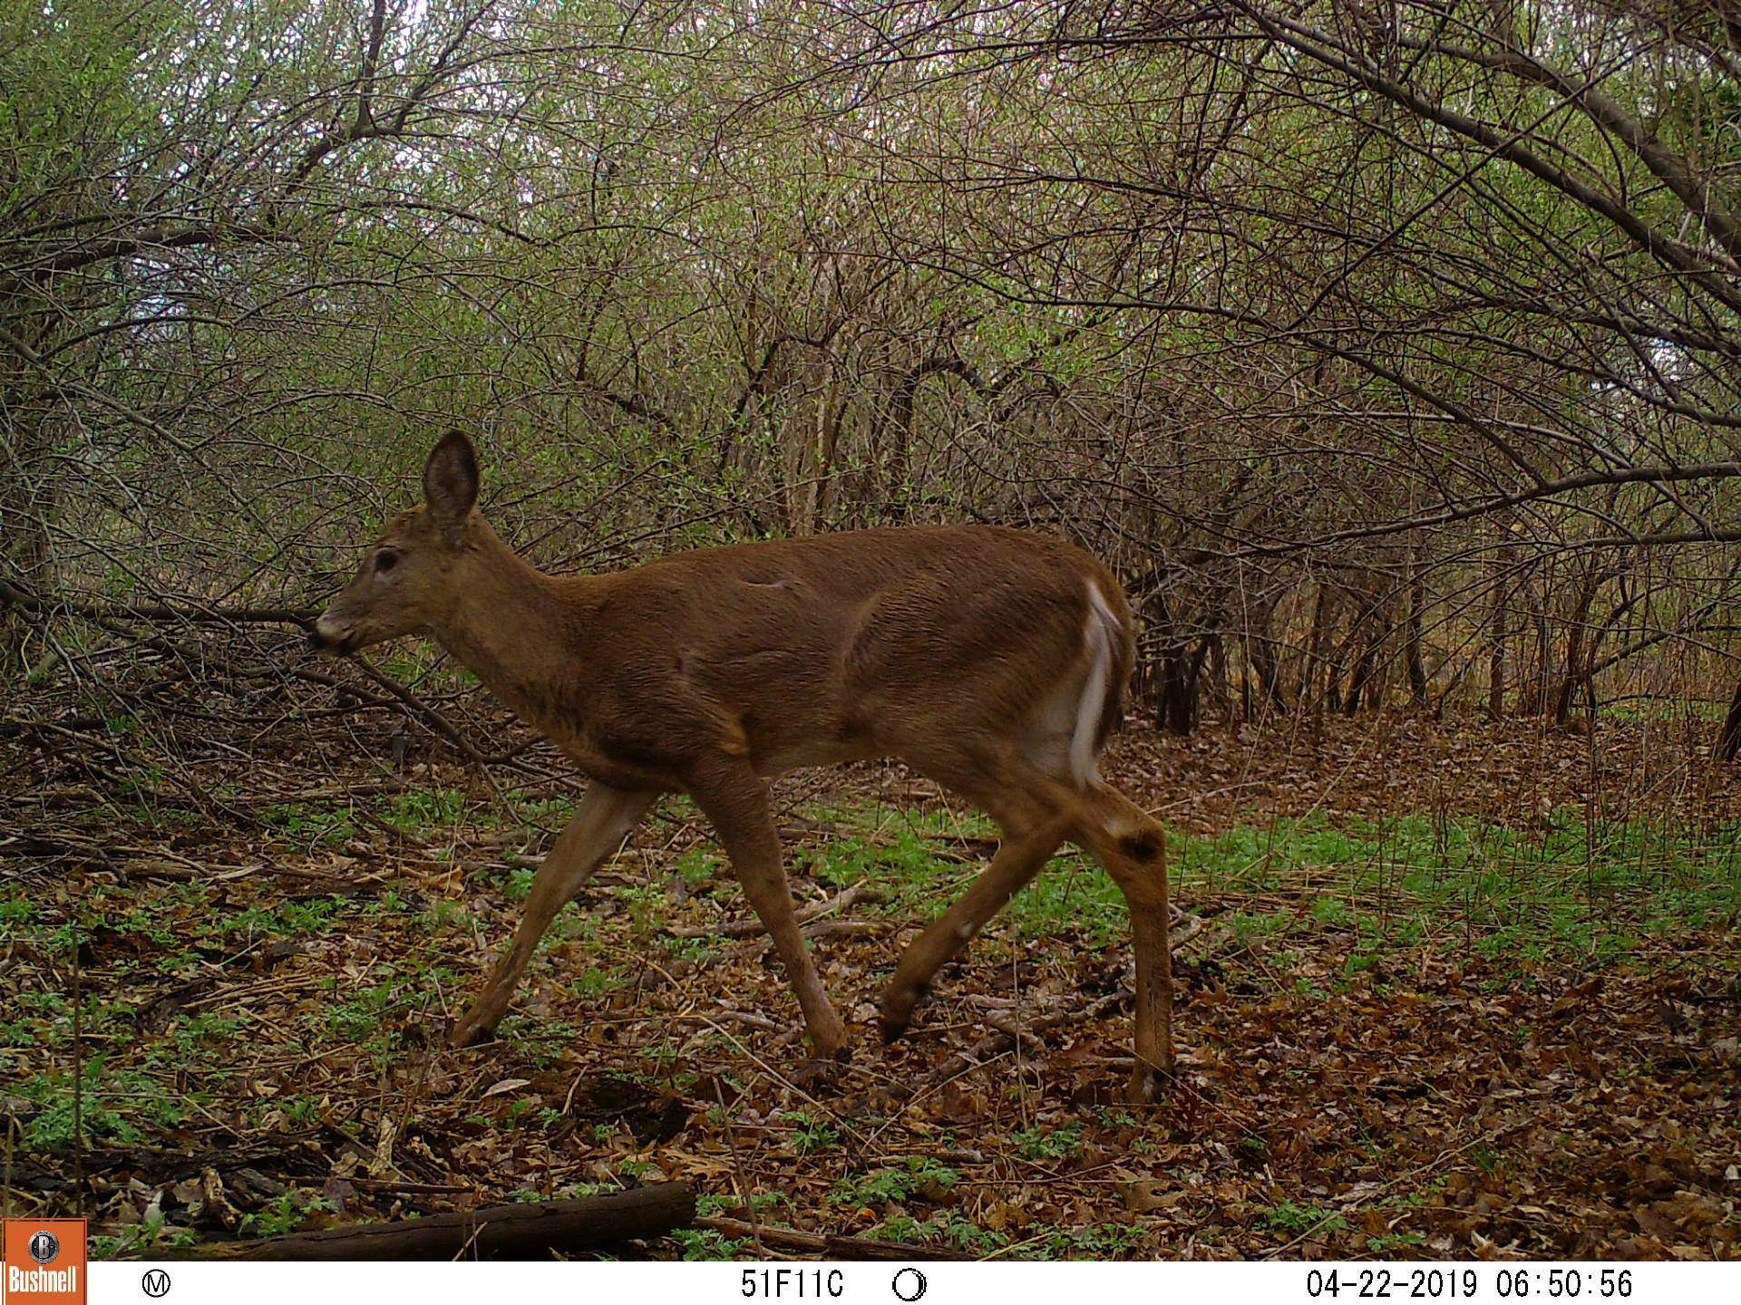
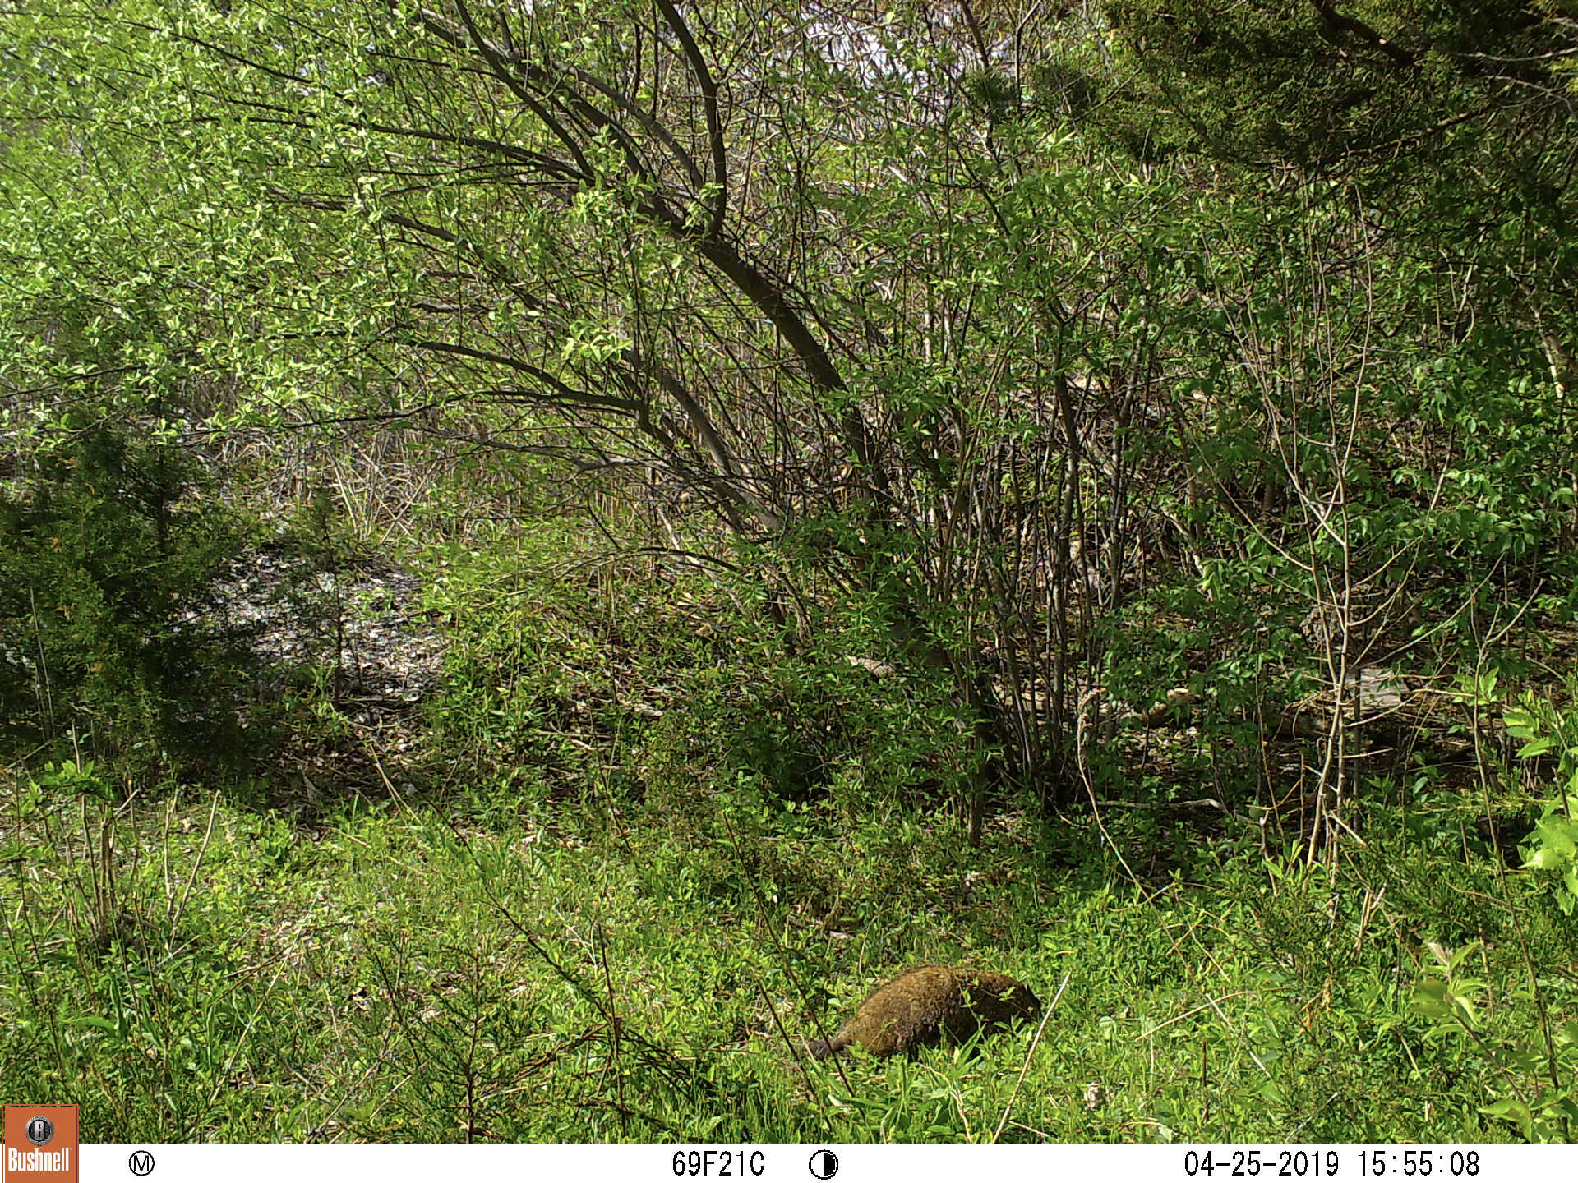
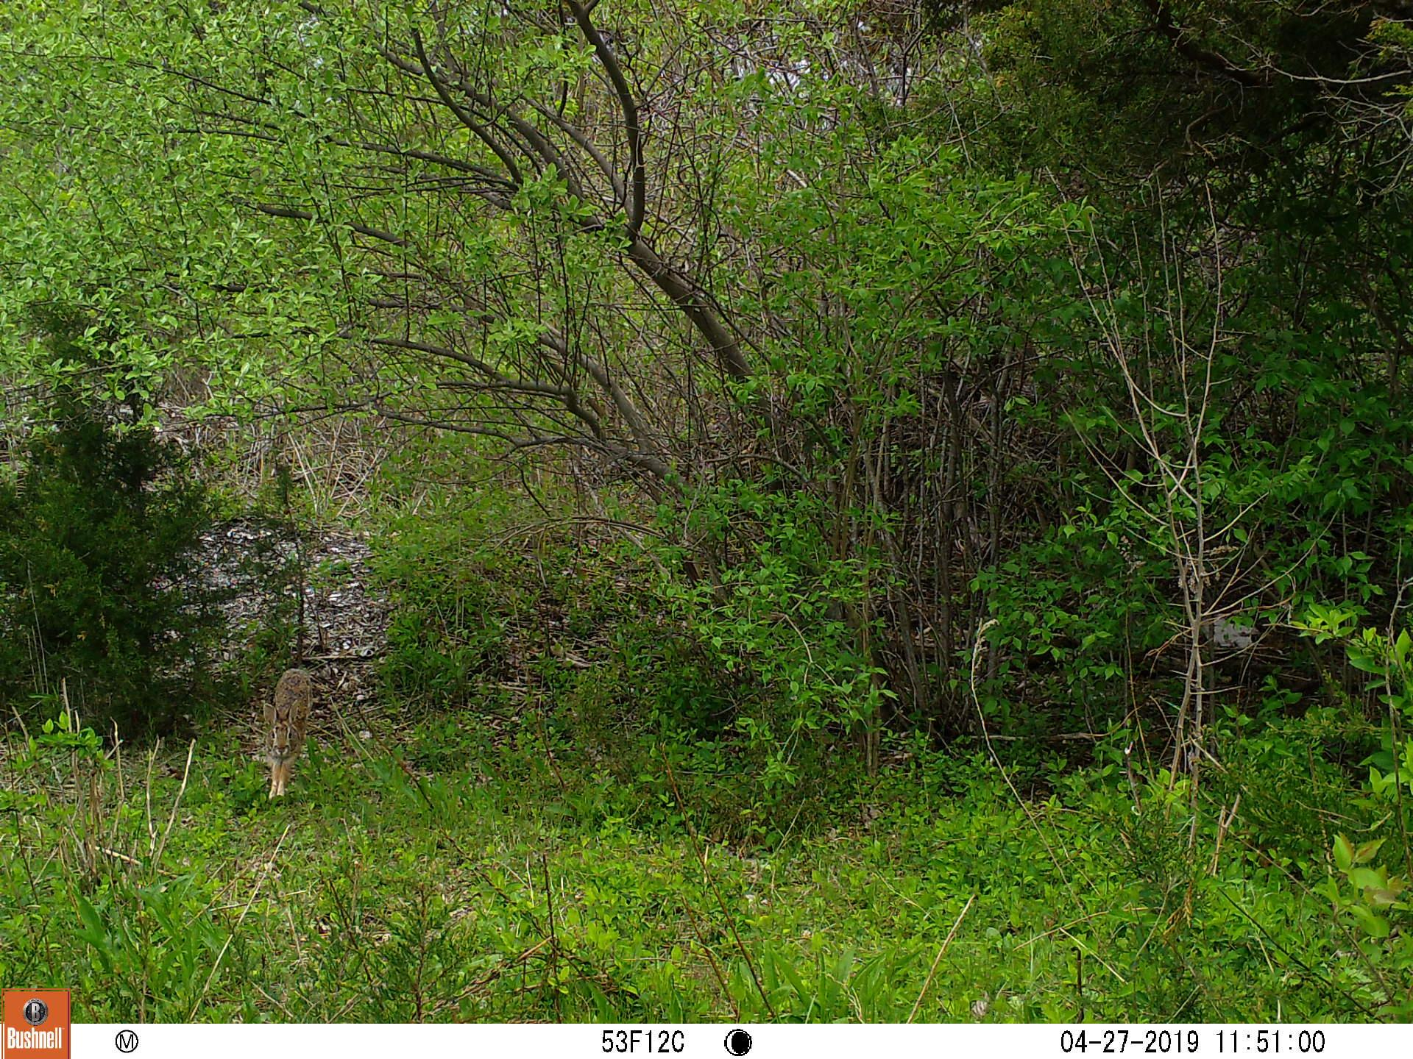
Notes:
Great Egret, osprey, tree swallow, white-tailed deer, Groundhog, Racoons, Possums

Slide 20
Benefits of Q Meadows
Sea level rise is an imminent threat to this region
Salt marshes help ameliorate flooding
Increasing Urbanization of New Haven
Important wildlife refuge
Respit for local community
Most of this local area has been deforested
Upland and marsh vegetation on this site allow for carbon storage
Notes:
AJ

Slide 21
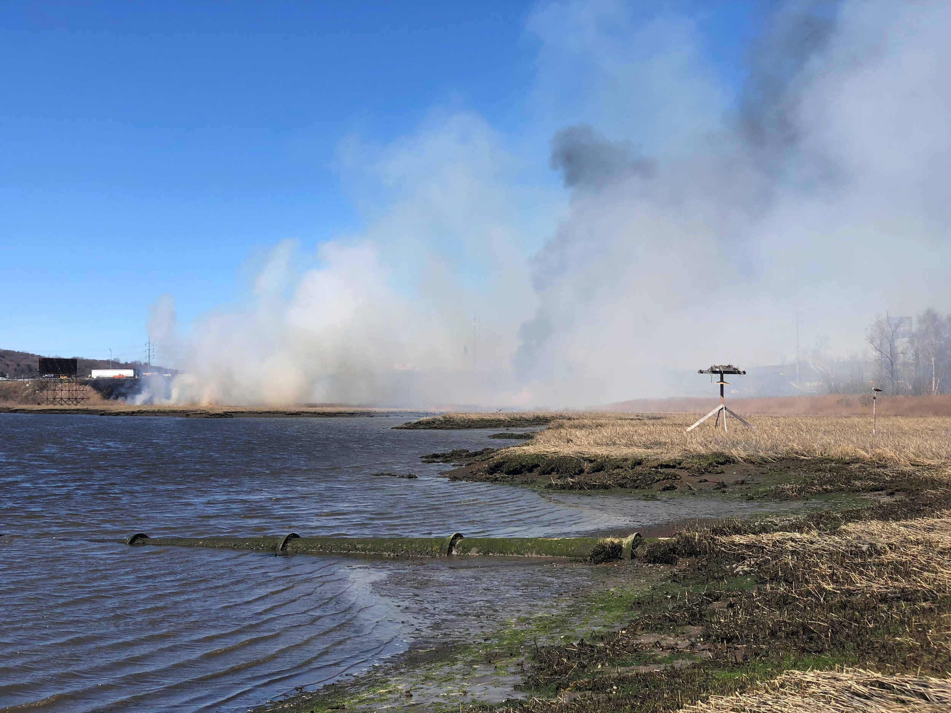
Notes:
Prone to disturbance from highways and railroads which will bring invasive species and fire.

Slide 22
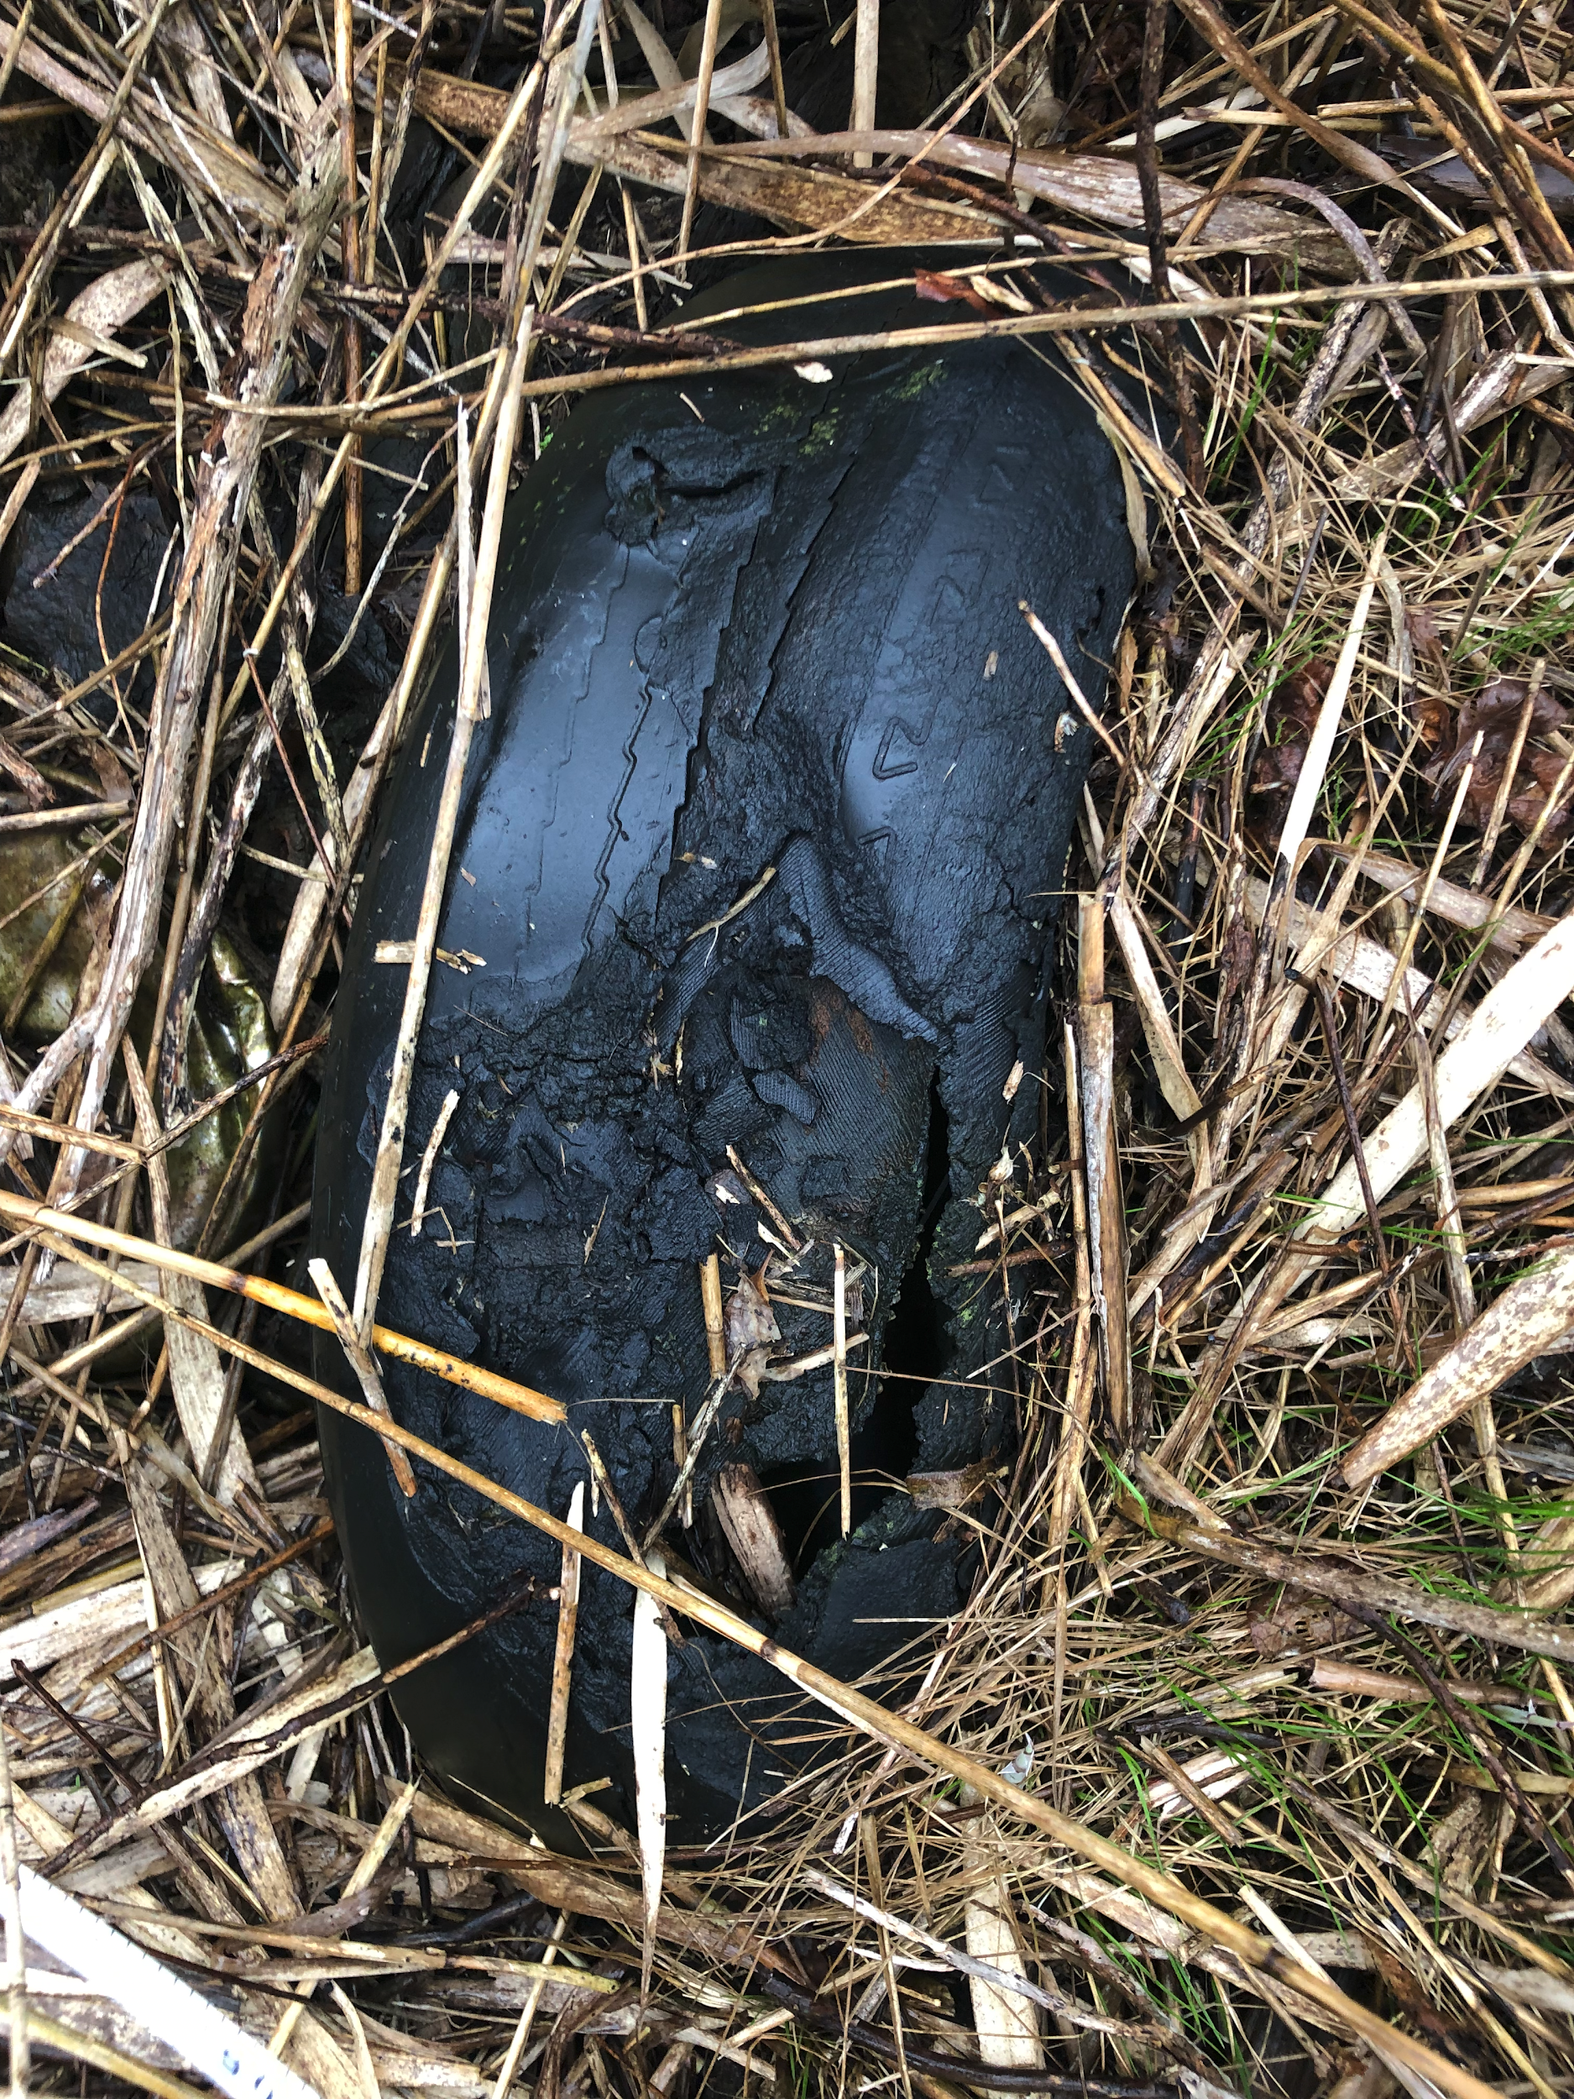
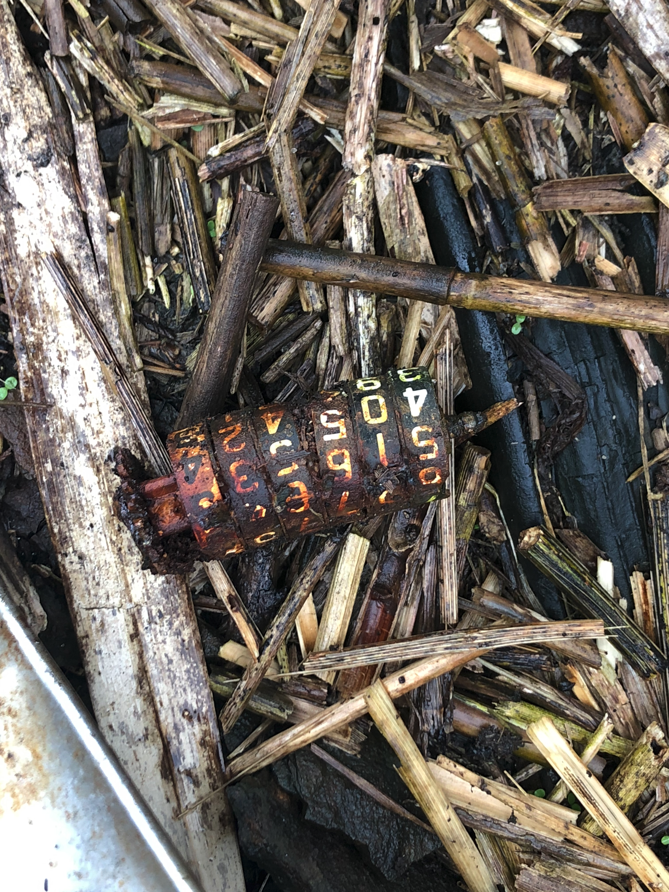
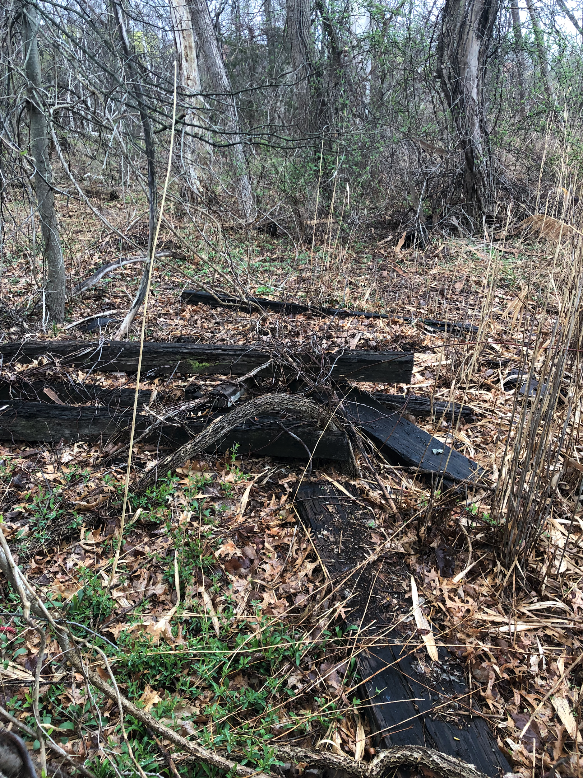
Notes:
Evidence of landfill

Slide 23
What is natural after all? When is Natural?
Ecosystems like this are not uncommon!
Long Wharf Nature Preserve → fill from I-95
Majority of New England salt marshes due to colonial-era deforestation?
Notes:
Ecosystems like this are not uncommon
This is true particularly in Connecticut where we have a relatively short post-industrial environmental memory
The Long Wharf Nature Preserve (another salt marsh managed by NHLT) is actually result of fill from I-95
Edwin Way Teale & the Trail Wood Audubon Sanctuary
The majority of New England salt marshes may actually be due to erosion from colonial-era deforestation.

Slide 24
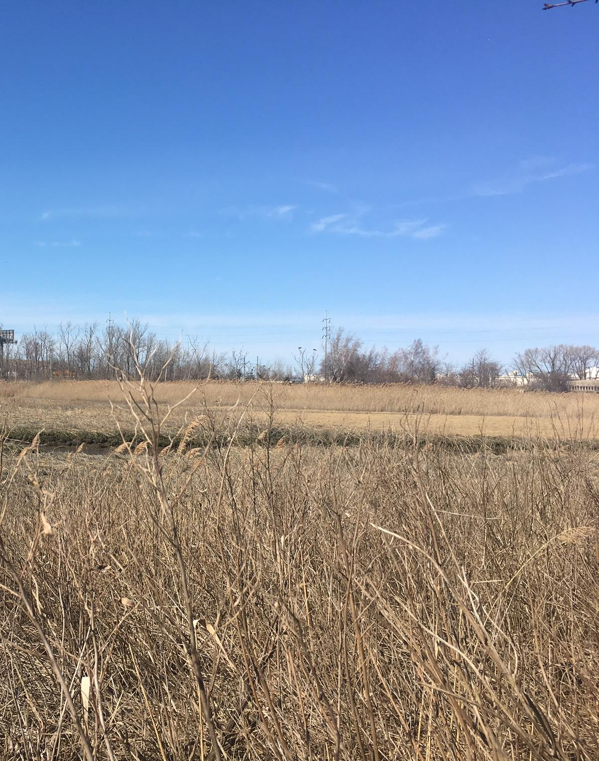
Potential Recommendations
Strategic invasive species removal to allow seedling growth/ forest succession & regeneration
Year-round camera traps to capture seasonal wildlife for example: bird migration
Consider high cost / potential futility of Phragmites removal with the possibility of unintended consequences.
Notes:
Considering the unique history of this site… we should consider what we hope it could be rather than attempt to restore it to a “natural” state that never actually existed.

Slide 25
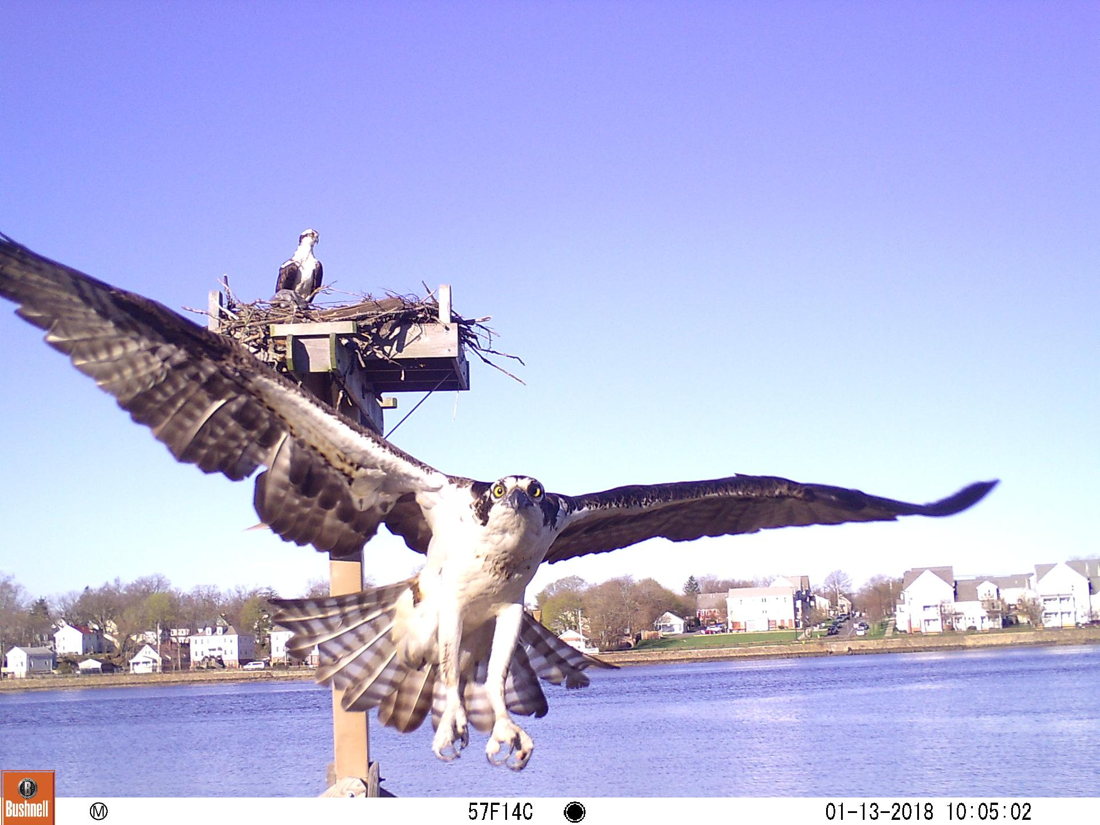
Thank You!
Questions?

